Slide 1
Crime Map
Ramon Isabela
January 1 – November 28, 2021

Slide 2
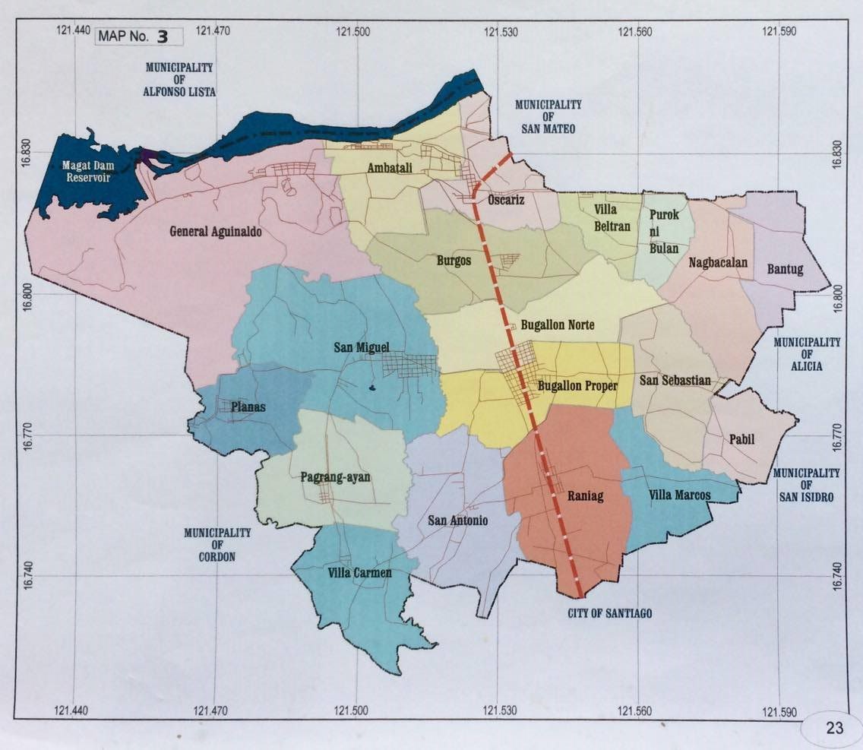
Crime Map against Person and Property
Legend:
Murder
Homicide
Physical Injury
Rape
Robbery
Theft
Carnap MV
Carnap MC
1
2

Slide 3
Crime Map – Non-Index
Legend:
Acts of Lasciviousness
Alarms & Scandal
Concubinage
Direct Assaults
Grave Threat
Frus/Attemp Murder
Resisting Authorities
1
1
1
1
1
1
1

Slide 4
Crime Map – Traffic Incident
Legend:
RIR in Homicide
RIR in Physical Injury
RIR in Damage to Property
1
2
2
1
1
1
1

Slide 5
Crime Map – Special Laws
Legend:
RA 7610
PD 1602
RA 9262
RA 9175
RA 9165
RA 10591
RA 8550
PD 705
RA 11332
1
1
1
1
1
1
1
1
1
1
1
1
1
1
1
1
1
1
1
4
1
1
2
1
1
1
2
1
1
1
1
1
1
80
3

Slide 6
Crime Map
Santiago City
January 1 – November 28, 2021

Slide 7
